Slide 1
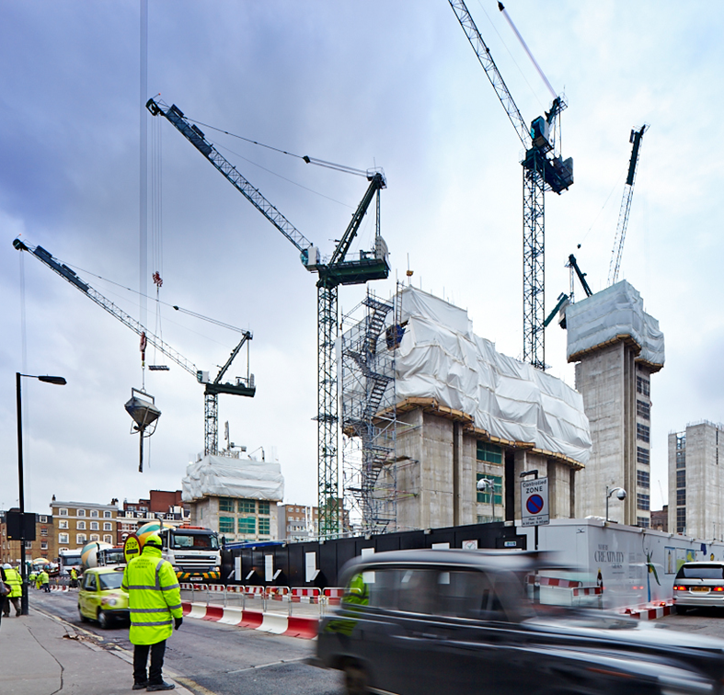
CHALLENGE #9 Understanding Activity Duration Variance in EPC Projects

Slide 2
CHALLENGE #9 Problem Statement
As a business, we would like you to help us understand our Activity Duration Variance. Can we apply machine learning to our schedule data to understand the features or conditions that are the biggest causes of duration variance in projects?

Slide 3
CHALLENGE #9 Detailed Description
SPS – Subsea Production Systems – delivers EPC Projects (Engineering + Procurement + Construction) for Oil Majors and National Oil Companies. These projects are managed through Primavera P6 and are made of multiple schedules, each with hundreds of Activities. Activity Durations are baselined, but there is variance vs Actual Durations that we would like to assess and potentially to minimise.
We have a dataset of 111 schedules – almost 100,000 activities. We would like to understand our Activity Duration Variance based on the P6 schedule data. Note that our interest here is not on the delay to start activities but on the start to finish durations.

Slide 4
CHALLENGE #9 Data Description
P6_Schedule_Data.csv – a csv file containing almost 100,000 activities for 111 Active Primavera P6 Schedules from Baker Hughes SPS business
Baker Hughes - EPC Project Activity Durations.pptx – a PowerPoint file containing more detailed information about Baker Hughes and the challenge
*Please note that all data, documents and submissions are for the purposes of the hackathon only, please do not copy, distribute or reproduce for any purpose without prior approval from the Author

Slide 5
Output
An analysis of the main drivers behind variance in activity durations
This will be a machine learning model that explains the variance in duration
You can split the completed activities into train and test data, and test your model on unseen activities
Your output could also include a dashboard with some visualisations of the most prominent drivers

Slide 6
Benefits
This will help us to address the areas where specific actions can be taken to reduce such variance

